Slide 1
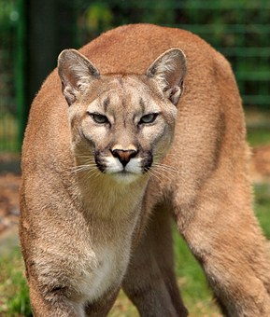
Welcome to
the
paredes library
See it
Believe it
Achieve it …
Enough said!

Slide 2
In order to be an
information literate citizen
you must know
how to use your library.

Slide 3
Hours
Monday – Thursday
7:45 a.m. – 4:00 p.m.
Wednesdays
Open until 4:45 p.m.
Friday
7:45 a.m. – 3:45
Closed during advisory

Slide 4
Expectations
Follow Paredes Pride
Return materials on time
Take responsibility for lost/damaged items
No gum, food, candy, or drinks
Have a library pass

Slide 5
Passes
Before school: in the morning pick up a pass from cafeteria (6th) or gym (7th and 8th)
When passes run out that means the library is full – do not leave the cafeteria or gym.

Slide 6
Passes
At lunch: on your way to the cafeteria, pick up a pass from the library. Go to lunch; come to the library the last 15 minutes of your lunch.
Class>>>Library>>>Cafeteria>>>Library>>>Class

Slide 7
Passes
After school: come directly to the library after dismissal No pass is needed.
At closing time you will need to go to an after-school activity or be picked up by your parents.

Slide 8
Passes
During class: have a pass signed by your teacher.
Place it in basket & sign in at circulation desk when you arrive
Have your pass signed by library staff and sign out when you leave

Slide 9
Finding materials
Online Public Access Catalog – OPAC
Non-fiction around the outside of the library
Fiction on the free-standing shelves
Ask for help if you can’t find what you’re looking for

Slide 10
Checking out materials
Know your student id number
Line up in front of circulation desk – 2 computers are available
Mrs. Grumbles or a student aide will check out your books to you

Slide 11
Check-out Policies
Maximum of 2 books or 1 book and 1 magazine checked out
Books are due in two weeks
Magazines are due in two days

Slide 12
Obligations
Overdue or lost items block students from:
Checking out additional items
Participating in dances, reward activities, field trips

Slide 13
Obligations
We WANT you to be able to check out books!
Tell Mrs. Grumbles about a lost or damaged book.
We will work something out!

Slide 14
Computer Use
Library computers are used for
catalog searches, educational research, and games accessed through the library’s website only.
No chatting, non-school-related e-mails, or downloading allowed.
Log out before leaving the computer.

Slide 15
Computer Use
All printing and copying requires permission from Mrs. Grumbles.
Cost
All black & white printing and copying costs 10¢/page
All color printing and copying costs 30¢/page

Slide 16
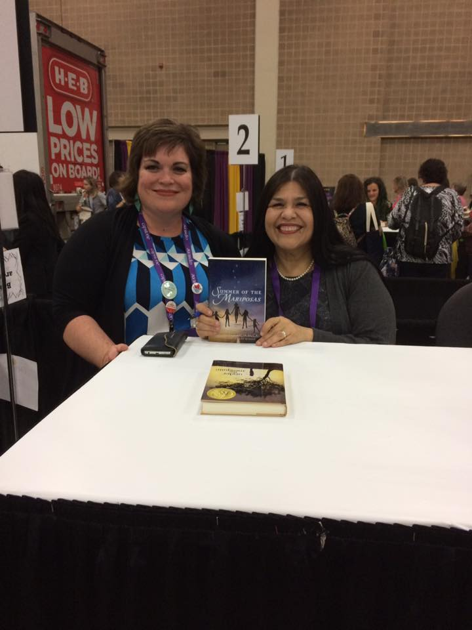
I’m looking forward to a wonderful year with you and I hope to see you in the library often!
Mrs. Grumbles

